Slide 1
QCA Realization of KMD Gates

Slide 2
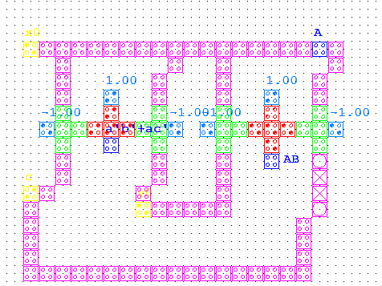
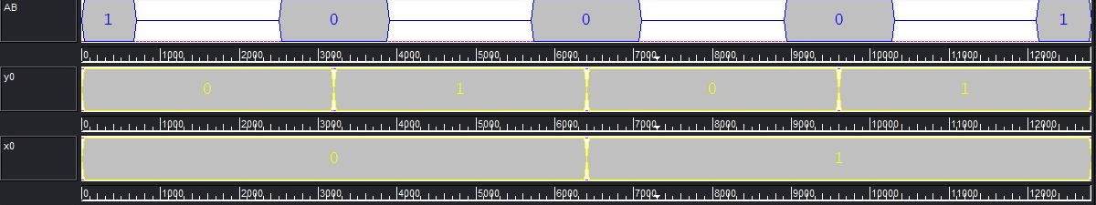
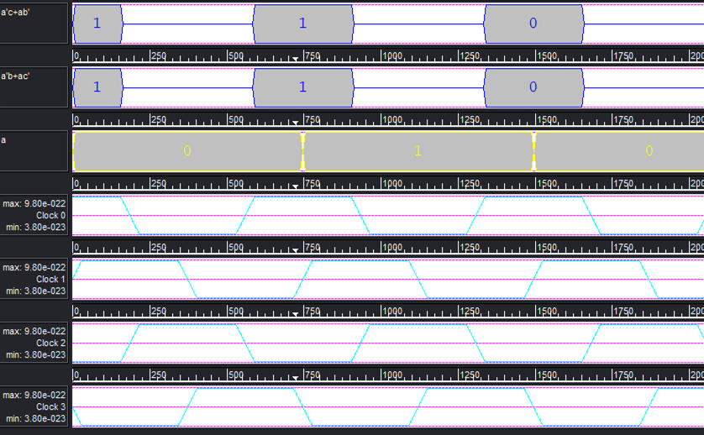
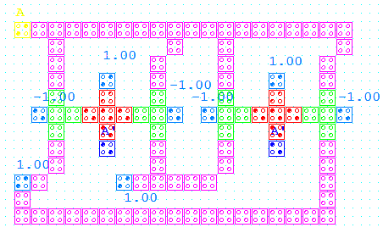
QCA Realization of KMD Gates
Inverter
KMD Gate1 (Inverter)
A
P=G
1
Q=A’
1
R=A’
AND Logic
KMD Gate2 (AND)
A
P=G
B
Q=G
1
R=AB

Slide 3
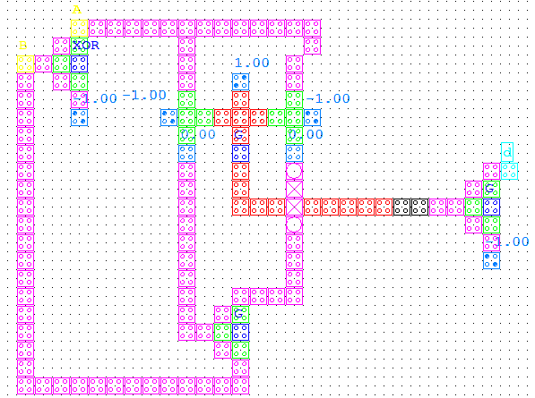
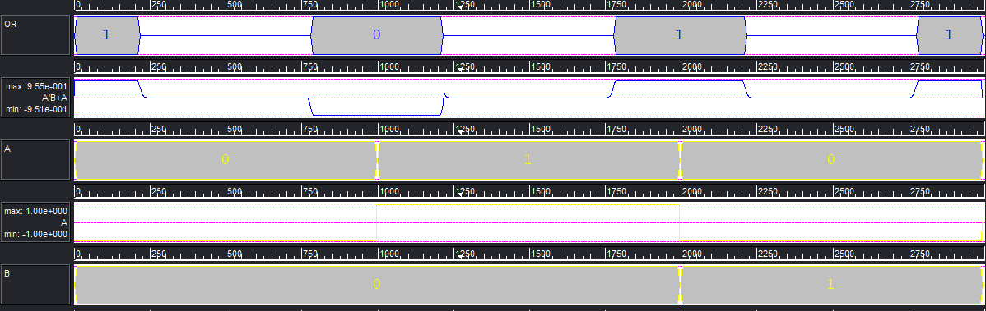
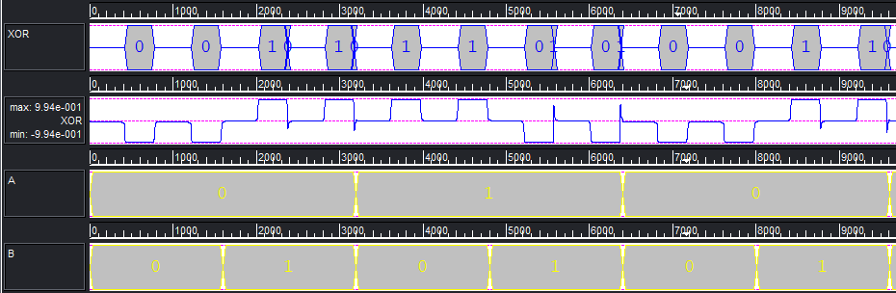
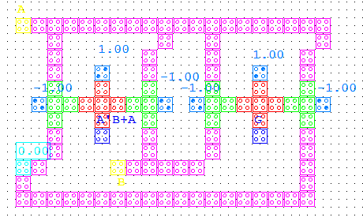
QCA Realization of KMD Gates Contd...
OR Logic
KMD Gate1 (OR)
A
P=G
B
Q=G
0
R=A’B⊕A
XOR Logic
A
KMD Gate3 (XOR)
P=A⊕B
0
Q=G
0
R=G
B
S=G

Slide 4
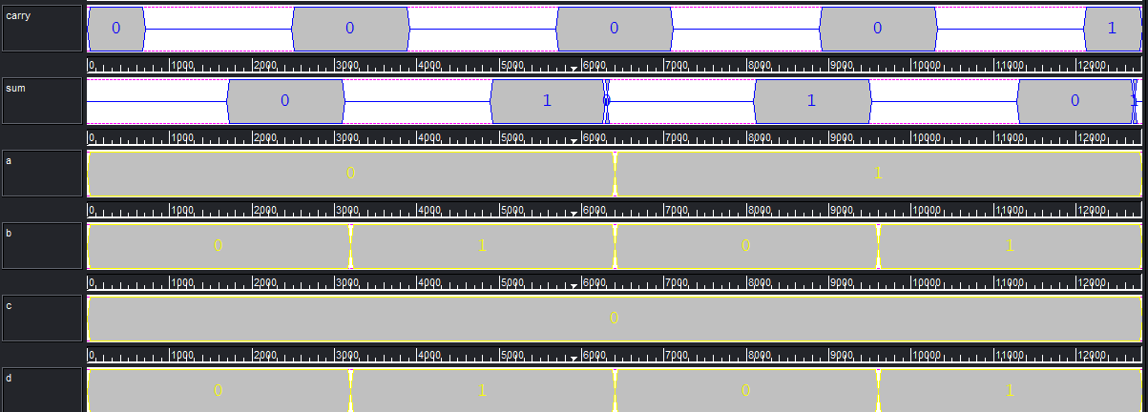
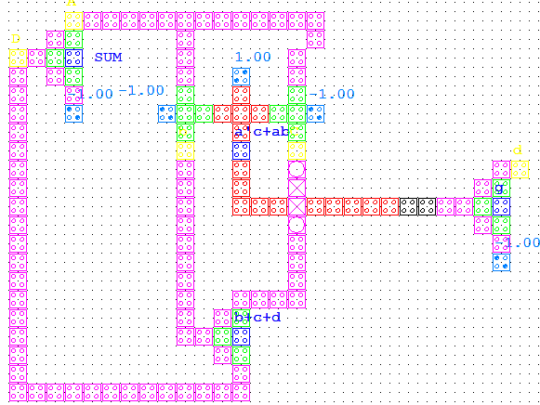
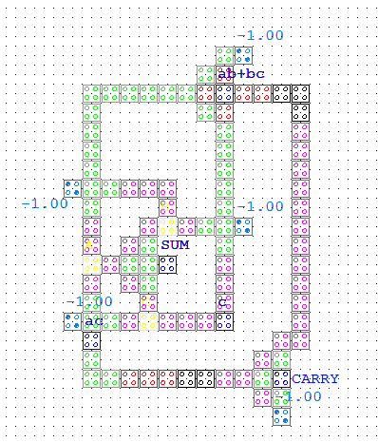
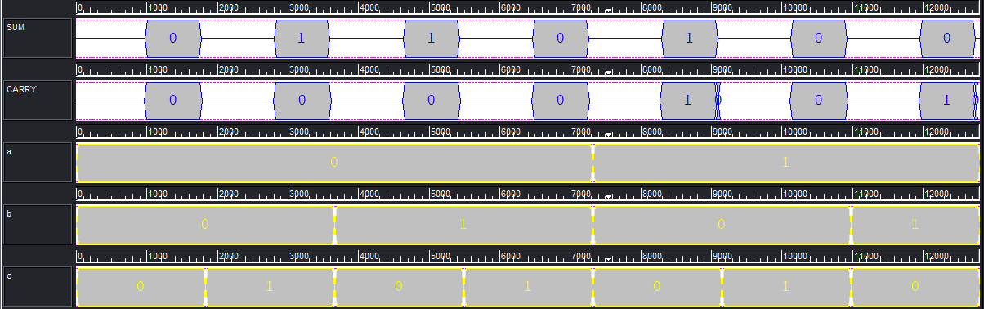
QCA Realization of KMD Gates Contd...
Half Adder
A
KMD Gate3 (Half Adder)
A⊕B
B
G
0
AB
B
G
Full Adder
A
KMD Gate4 (Full Adder)
G
B
G
C
A⊕B⊕C
0
A(B⊕ C)⊕BC
0
G

Slide 5
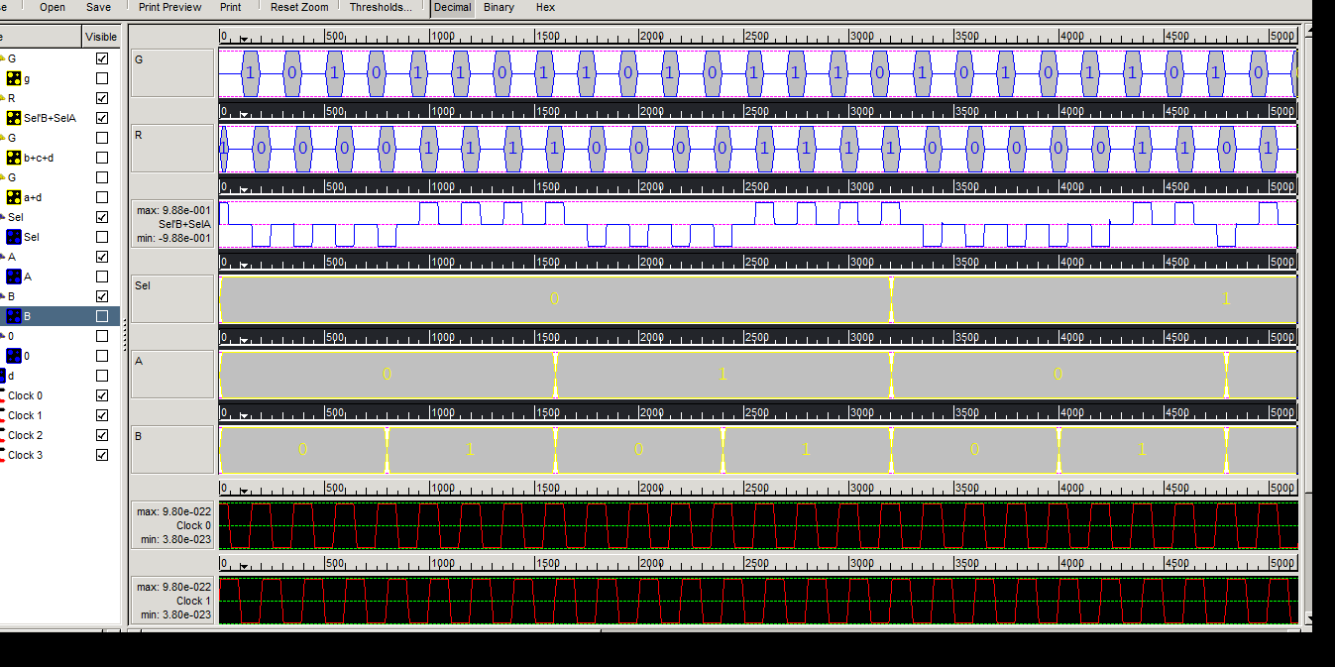
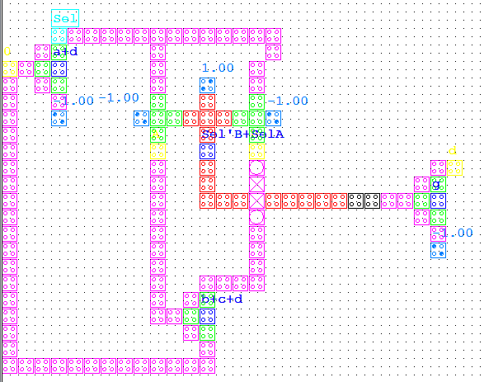
QCA Realization of KMD Gates Contd...
Multiplexer
Sel
KMD Gate3 (Mux)
P=G
A
Q=G
B
R=Sel’B⊕SelA
0
S=G

Slide 6
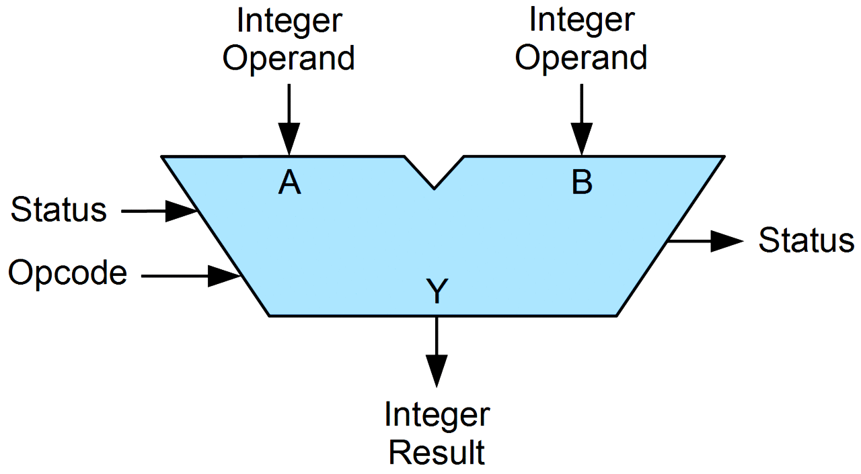
Arithmetic Logic Unit

Slide 7
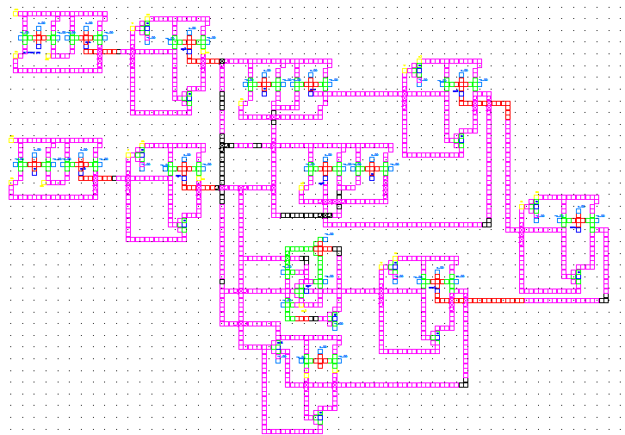
QCA Realization of ALU (Approach 1)

Slide 8
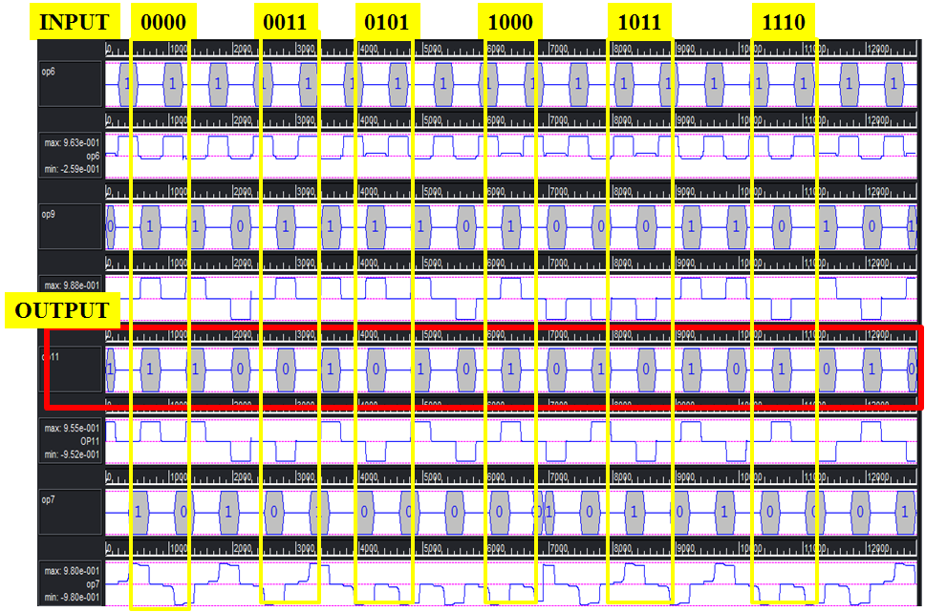
QCA Simulation of ALU (Approach 1)

Slide 9
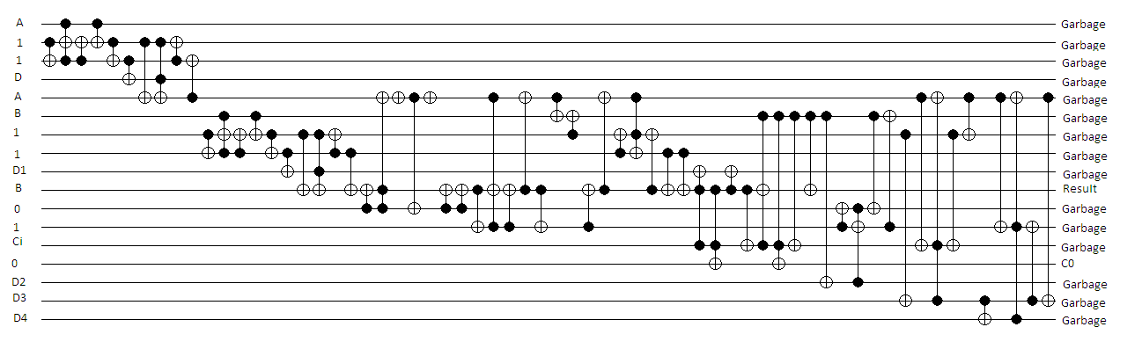
Quantum Circuit of ALU (Approach 1)

Slide 10
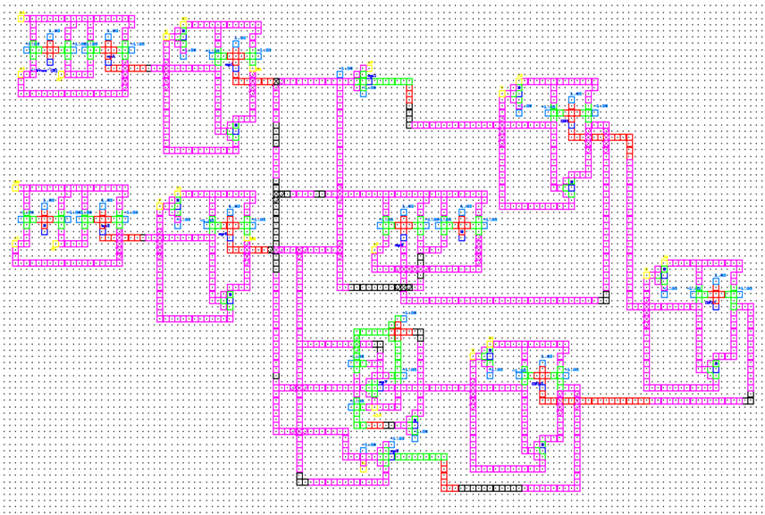
QCA Realization of ALU (Approach 2)

Slide 11
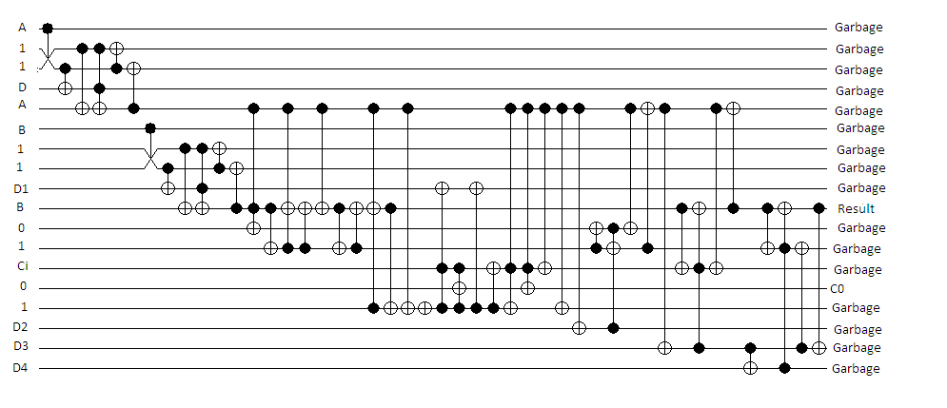
Quantum Circuit of ALU (Approach 2)

Slide 12
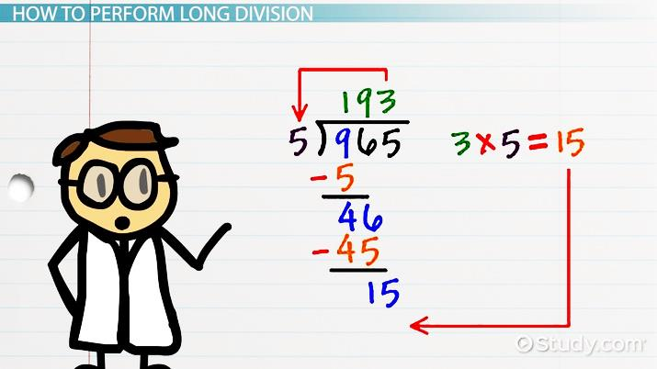
Floating Point Division

Slide 13
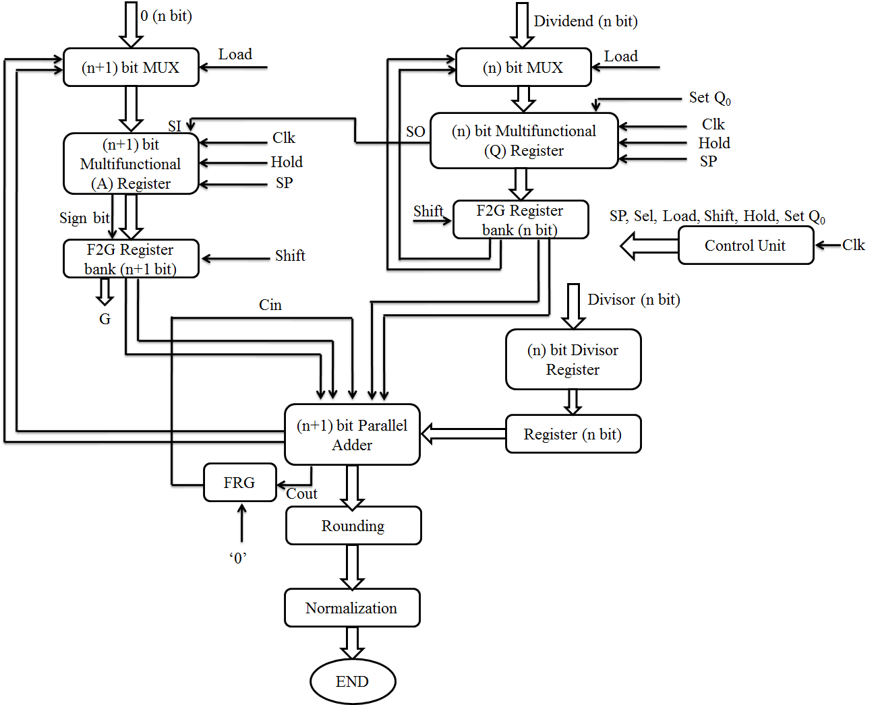
FP Division Architecture

Slide 14
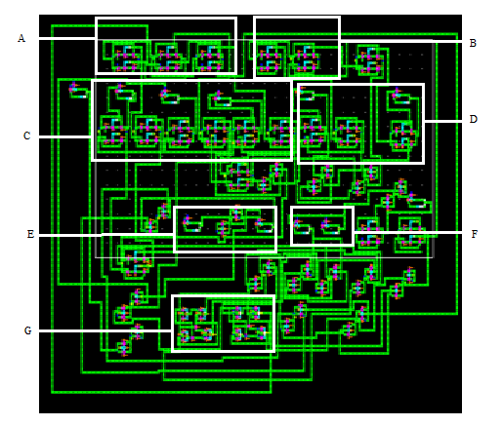
QCA Realization of Division Unit
A) 3-bit Multiplexer
B) 2-bit Multiplexer
C) 3-bit Shift Register
D) 2-bit Shift Register
E) Rounding Register
F) Normalization Register
G) Parallel Adder

Slide 15
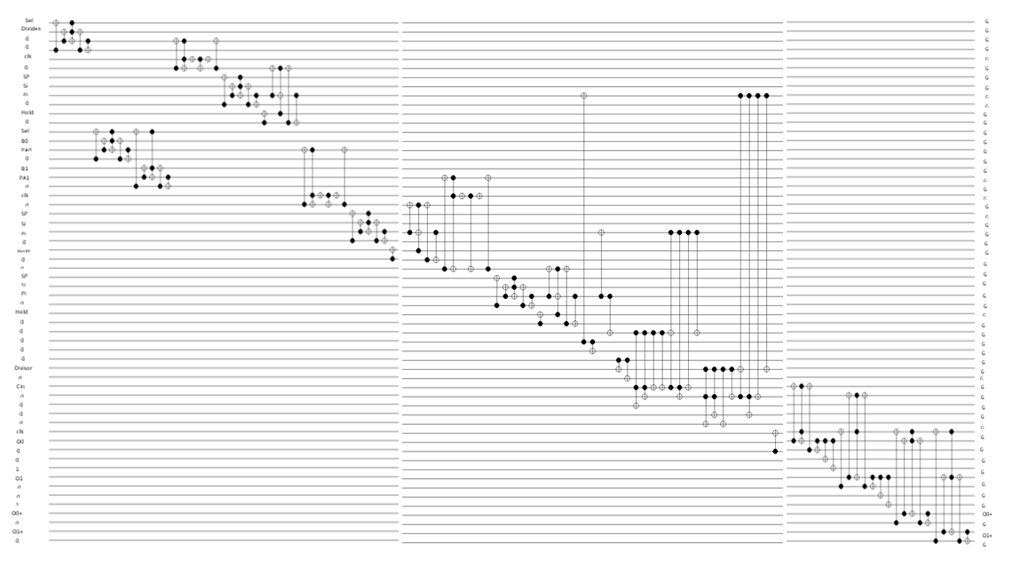
Quantum Circuit of Division Unit

Slide 16
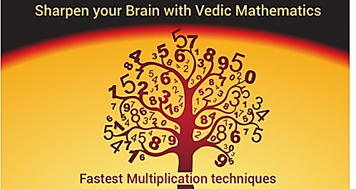
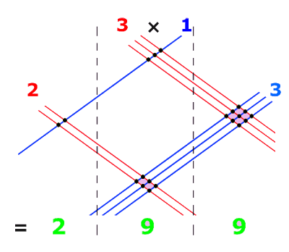

Vedic Multiplier

Slide 17
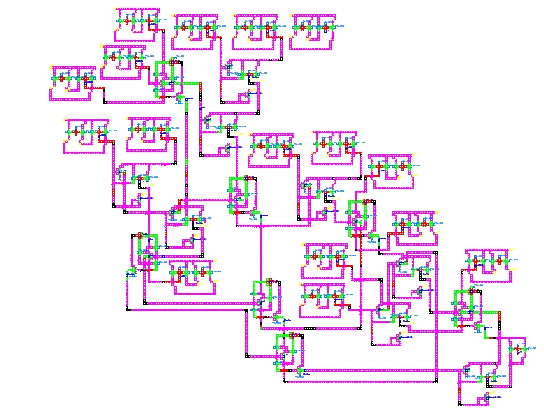
QCA Realization of Vedic Multiplier (4×4)

Slide 18
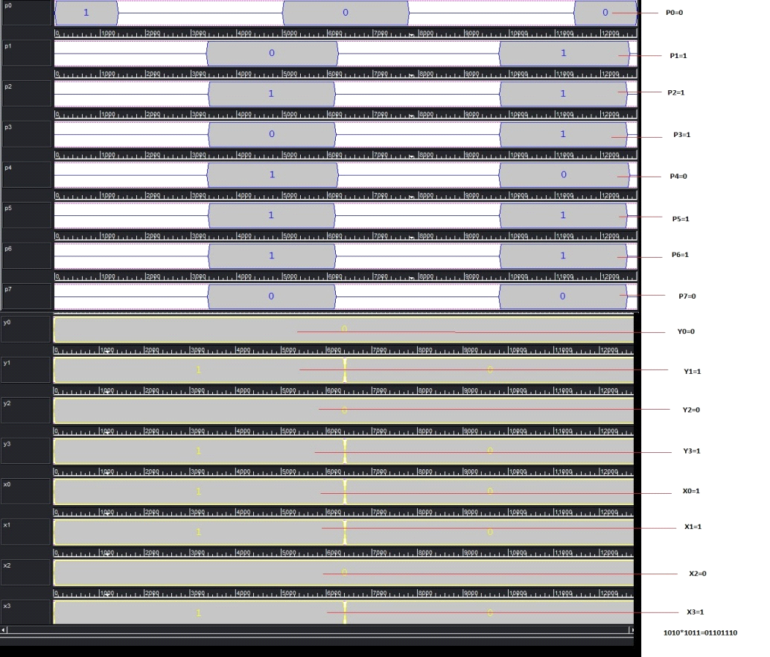
QCA Simulation of Multiplier

Slide 19
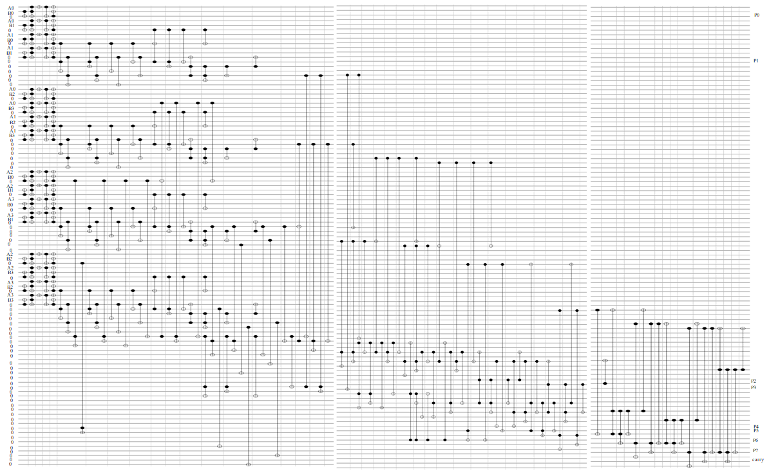
Quantum Circuit of Vedic Multiplier (4×4)

Slide 20
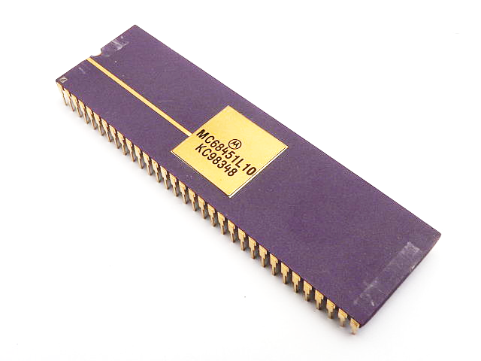
Memory Unit

Slide 21
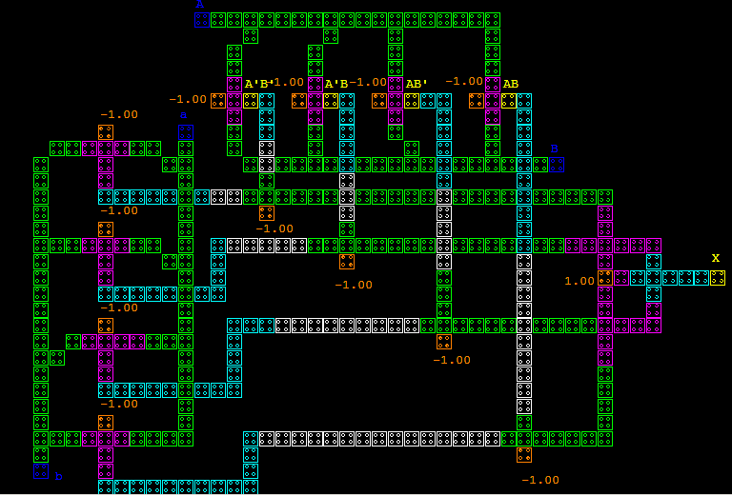
QCA layout of Address Checker Block (Logical crossing)
Red box indicates right address decoder
Blue box indicates left address decoder

Slide 22
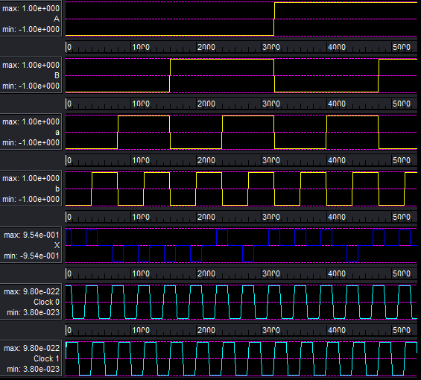
Simulation result of Address Checker Block (Logical crossing)
Input A=0,B=0,a=1,B=0
Output X=0

Slide 23
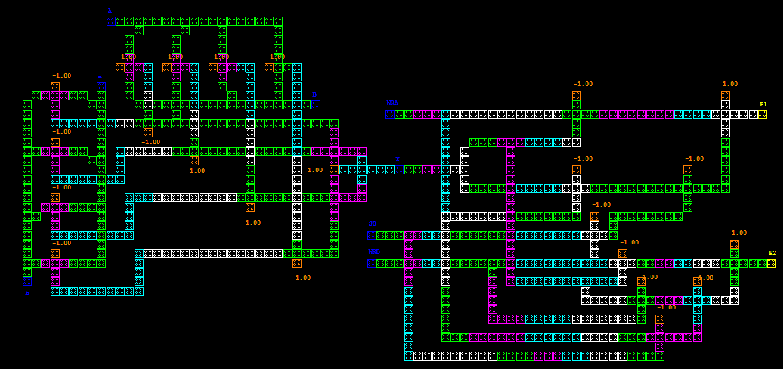
QCA layout of Control Logic Block (Logical crossing)
Red box indicates Address checker block

Slide 24
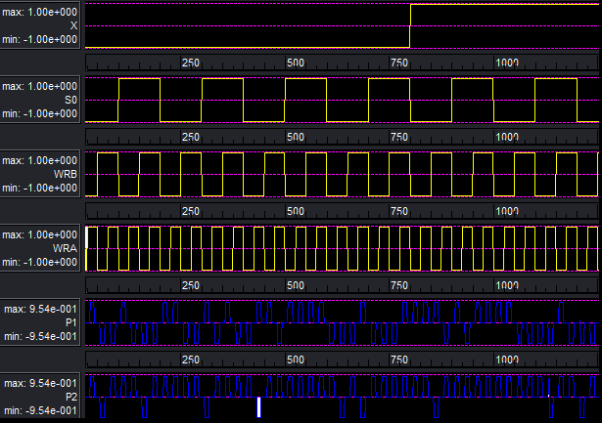
QCA layout of Control Logic Block (Logical crossing)
Inputs X=0, WRA=0, S0=0, WRB=1
Outputs P2=1

Slide 25
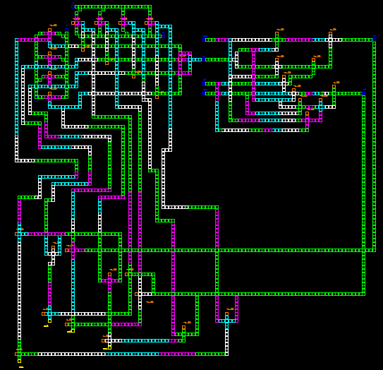
QCA layout of AND-OR block for write/read signal (Logical crossing)
Address checker block
Control logic block

Slide 26
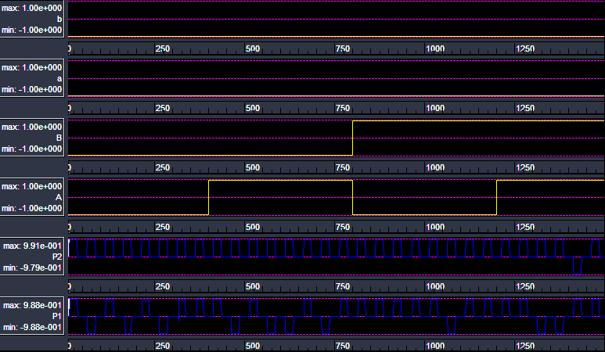
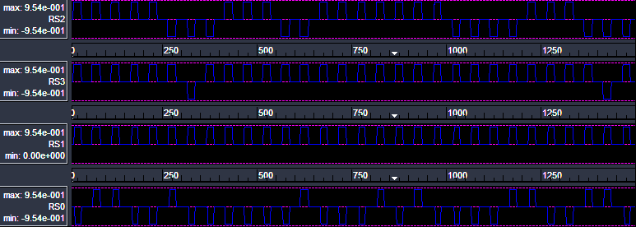
Simulation result of AND-OR block for write/read signal (Logical crossing)
Inputs P1=1, P2=0,a=1,b=0,A=1,B=0
Outputs RS2= 1

Slide 27
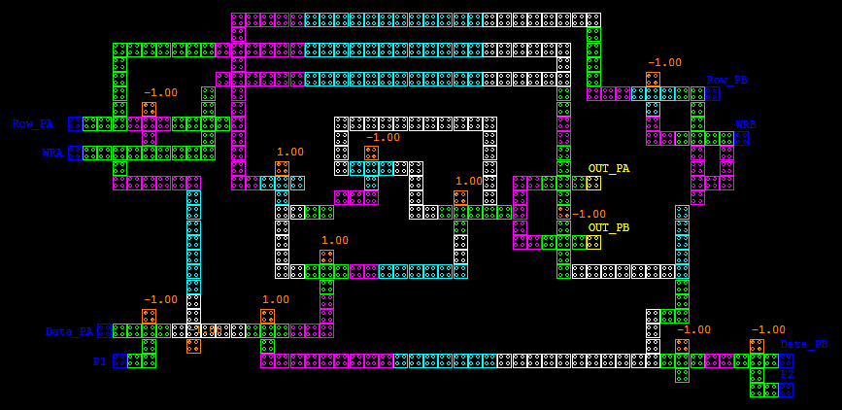
QCA layout of macro memory cell (Logical crossing)

Slide 28
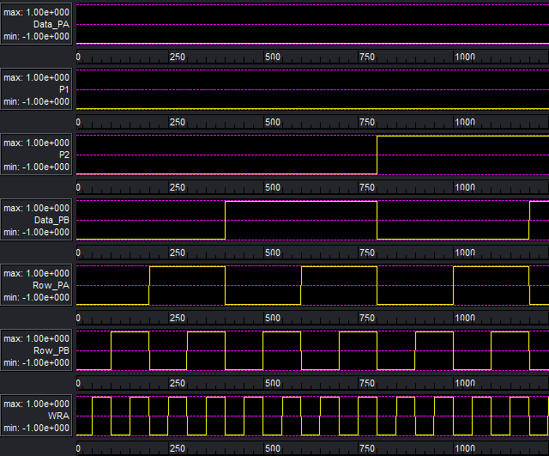
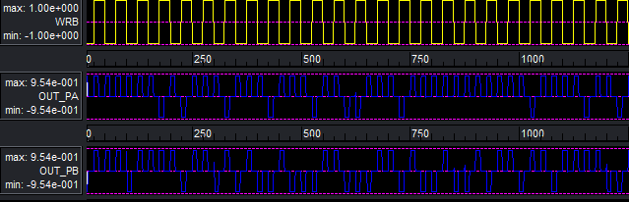
Simulation result of macro memory cell (Logical crossing)
Inputs Row_PB=1, WRB=0
Output OUT_PB=1

Slide 29
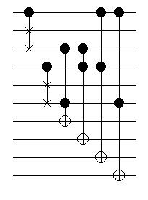
Quantum Equivalent Circuit of 2 to 4 Decoder
A
G
Parameters | Fredkin Gate | Toffoli Gate | Total
Quantum cost | 2 nos.×5 | 4 nos.×5 | 30
Constant Input | 4 | 4 | 8
Garbage Output | 4 | 0 | 4
Gate Count | 2 | 4 | 6
Logical Calculation | - | - | 4α+2β +4𝛾
1
G
1
A’
G
B
1
G
1
B’
0
A’B’
0
A’B
0
AB
0
AB’

Slide 30
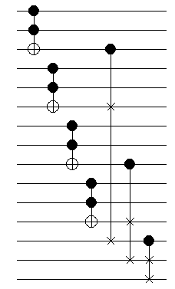
Quantum Equivalent Circuit of Address Checker Block
Parameters | Fredkin Gate | Toffoli Gate | Total
Quantum cost | 3nos.×5 | 4nos.×5 | 35
Constant Input | 3 | 4 | 7
Garbage Output | 2 | 10 | 12
Gate Count | 3 | 4 | 7
Logical Calculation | - | - | 4α+3β +4𝛾
d0
G
D0
G
0
d0·D0
d1
G
D1
G
0
d1·D1
d2
G
D2
G
0
d3
d2·D2
G
D3
G
0
d3·D3
1
G
1
G
1
X

Slide 31
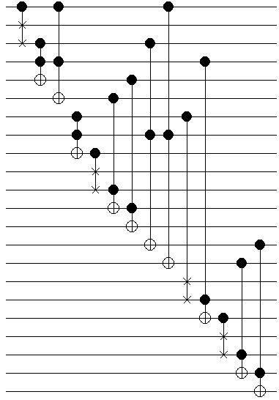
Quantum Equivalent Circuit of Control Logic Block
X
G
Methods | Fredkin Gate | Toffoli Gate | Total
Quantum cost | 4nos.×5 | 10nos.×5 | 70
Constant Input | 8 | 10 | 18
Garbage Output | 5 | 7 | 12
Gate Count | 4 | 10 | 14
Logical Calculation | - | - | 10α+4β +10𝛾
0
0
X’
WRA
X’WRA
0
XWRA
0
G
S0
G
WRB
G
0
G
1
G
1
(S0WRB)’
0
XWRA(S0WRB)’
1
P1
0
X’WRB
0
XWRB
1
G
1
S0
0
G
1
G
1
(S0’SRA)’
0
XWRB(S0’WRA)’
0
P2

Slide 32
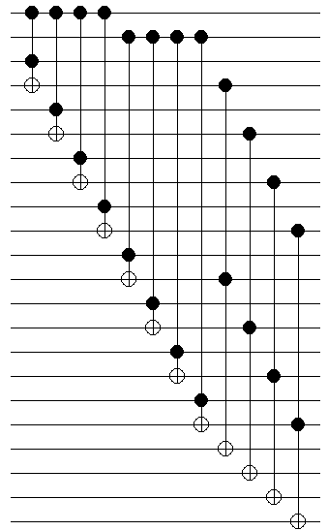
Quantum equivalent circuit of Data router
P1
G
P2
G
d0
G
0
P1·d0
Parameters | Toffoli Gate
Quantum cost | 60
Constant Input | 12
Garbage Output | 10
Gate Count | 12
Logical Calculation | 12β +12𝛾
d1
G
0
P1·d1
d2
G
0
P1·d2
d3
G
0
P1·d3
D0
G
0
P2·d0
D1
G
0
P2·d1
D2
G
0
P2·d2
D3
G
0
P2·d3
0
RS0
0
RS1
0
RS2
0
RS3

Slide 33
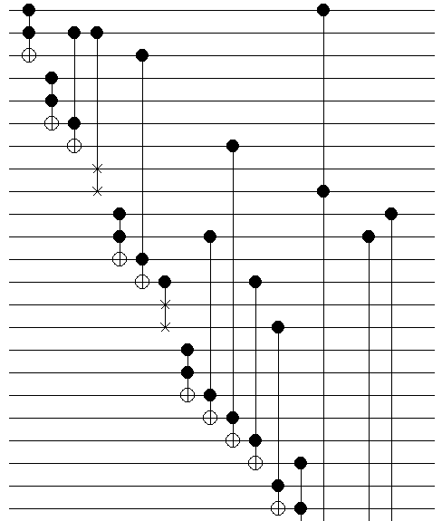
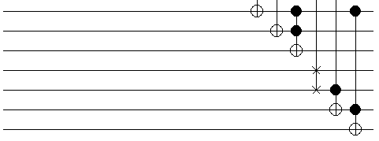
Quantum equivalent circuit of macro memory cell
Methods | Fredkin Gate | Toffoli Gate | Total
Quantum cost | 3nos.×5 | 15nos.×5 | 90
Constant Input | 6 | 16 | 22
Garbage Output | 3 | 9 | 12
Gate Count | 3 | 15 | 18
Logical Calculation | - | - | 10α+4β +10𝛾
RSA
G
W/RA
G
0
RSA·W/RA
P1
G
DIA
G
0
P1·DIA
0
W/RA·P1DIA
1
G
1
W/RA’
RSB
G
W/RB
G
0
RSB·W/RB
1
RSAW/RA·RSBW/RB
1
G
1
(RSAW/RA·RSBW/RB)’
P2
G
DIB
G
0
P2·DIB
0
P2DIB·W/RB
1
(P2DIB·W/RB)+(P1DIA·W/RA)
0
((P2DIB·W/RB)+(P1DIA·W/RA))·(RSAW/RARSBW/RB)
0
G
0
(RSAW/RARSBW/RB)·0
1
(((P2DIB·W/RB)+(P1DIA·W/RA))·(RSAW/RARSBW/RB))·((RSAW/RARSBW/RB)·0)
0
RSA·W/RA’
0
O/P Port A
1
G
1
WRB’
0
O/P Port B
0
[[(P2DIBW/RB+P1DIA)·(RSAW/RARSBW/RB)].[(RSAW/RA·RSBW/RB)·0]]·[RSB·WRB’]

